Slide 1

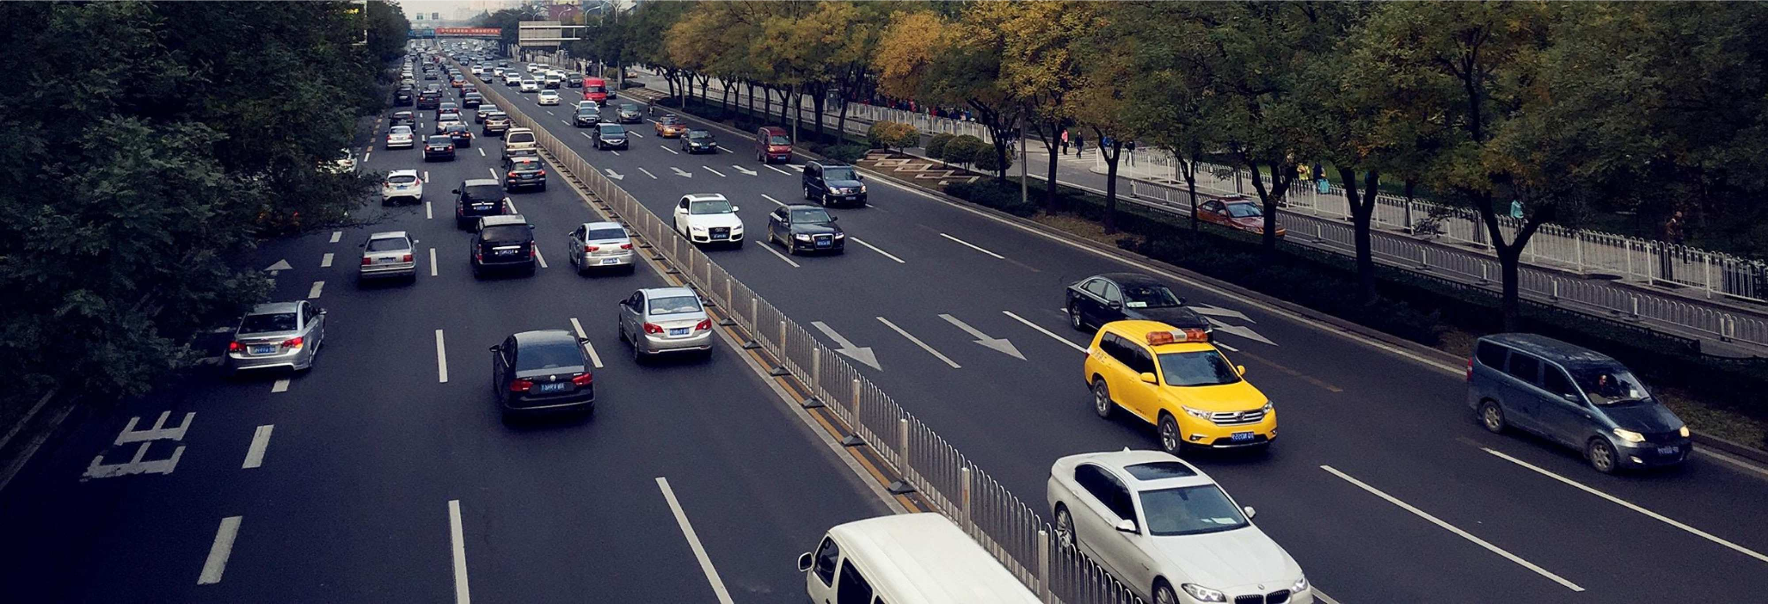



EFMFM- Employee Transport Solution & Services platform
An integrated approach
EFMFM- Employee Transport Solution & Services platform
An integrated approach
Follow us on:
NGFV India Pvt. Ltd.| www.efmfm.com

Slide 2

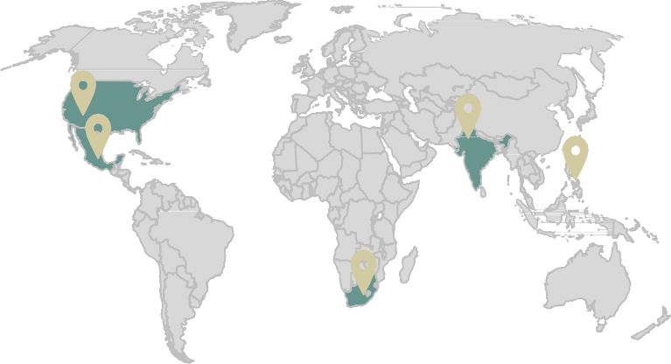

























Overview
Organization Global Presence Operational Foot - Print
efmfm is a product from NGFV stabilized in 2015. efmfm SaaS platform for Employee Transport Solutions & Services.
NGFV is part of Newt Global Group which was established in 2004 in Dallas, Texas, USA . It is today a Leader in Cloud Transformation.
USA
India
Philippines
Countries
4
Cities
14
Registered users
2,69,438
Mexico
SA
Facilities catered
118
Trips managed
3,35,335
Cabs engaged
6,072
EFMFM
ETMS
Employee Transport
Automation Solution
EFMFM
IVMS
Vehicle Dynamics
Solution
EFMFM
SPOT Hire
Ad-hoc requests
Solution
EFMFM
Car-Pool
Corporate carpooling
Solution
EFMFM
Logix
Middle Mile delivery
Solution
_{To be launched} To be launched
Corporate relationships
Partial List of Customers
NGFV India Pvt. Ltd.| www.efmfm.com

Slide 3
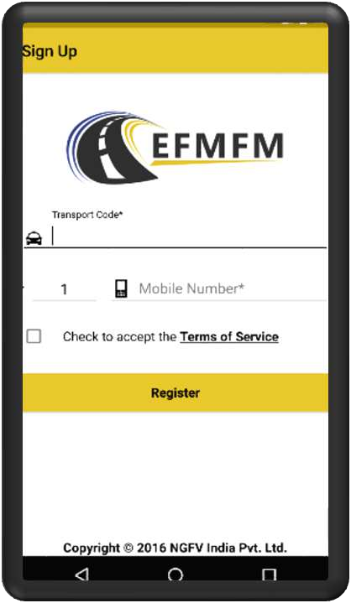

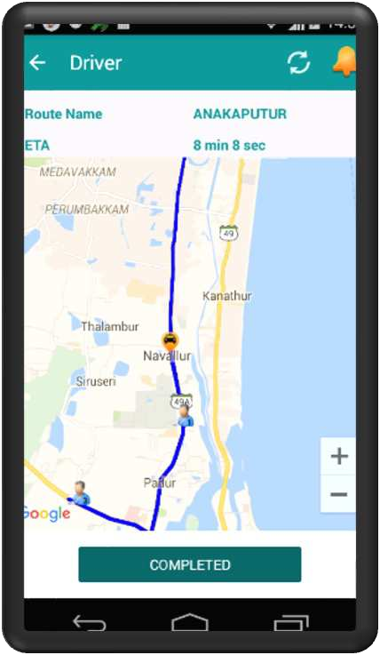

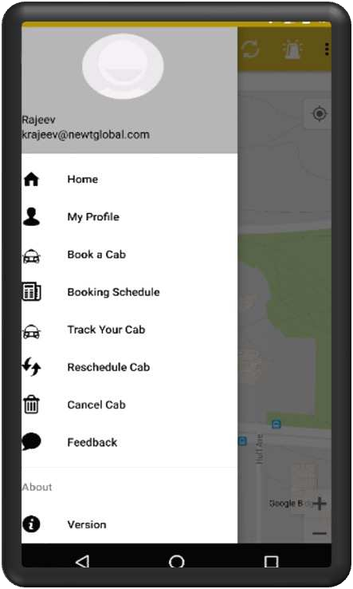















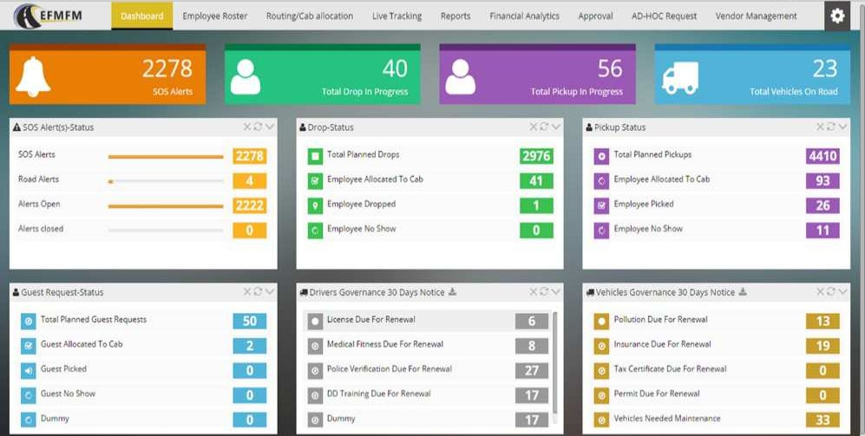
ETMS Modules
Employee Application
Track your cab
Driver Application
Field Application
Vendor supervisors -
Track trips, Assign Ad hoc Vehicle/drivers, Changes route
Transport team- Change route,, shift vehicle and driver real time, manage unscheduled employee request
Compliance team – before trip vehicle /drive inspection , COVID compliance
Security team- vehicle release information, guard allocation
Digital trip-sheets
Multilingual
IVR / normal calls
Easy navigation/voice interface
On-boarding/off-boarding – Employee & Escort
Important Office Notification
Schedule Management
SOS Alerts
Instant Feedback
IVR ( number masked calling )
Ad hoc cab request
Important Office Notification
Command Center /Web Dashboard
The web platform of efmfm is hosted on cloud and can be accessed from anywhere. The transport manager can easily Manage booking, Ongoing trips, Real-time tracking & analysis, and MIS reports as he has full control of the operations through the web portal. An operations dashboard provides a quick view of all trips and issues that need to be addressed. Also, we provide a management dashboard that shows the long-term strategic view of operations and profitability analysis of the business.
Rostering
Cab allocation
Live Tracking
Reports
Financial Analytics
Vendor management
NGFV India Pvt. Ltd.| www.efmfm.com

Slide 4









Comprehensive .. Flexible … Agile
Easy to use
Single URL | Extensively Configurable | Completely Paperless | Fuel Type | Vehicle capacity
Transport type
Home | Nodal | Metro-Shuttle | Inter-facility-Shuttle
User requests
Regular shifts | Late stay | Adhoc | Spot-rental
Booking options
Self | SPOC | Manager | Transport team
Hybrid working - Booking flexibility
Day/Date | Shift/Trip | Office location | Transport type
Compliances – Completely Digital & alert based
Vendor | Vehicle | Driver
Vendor billing
Package| lms | Trip l FTE/PAX
COVID
Ready
NGFV India Pvt. Ltd.| www.efmfm.com

Slide 5

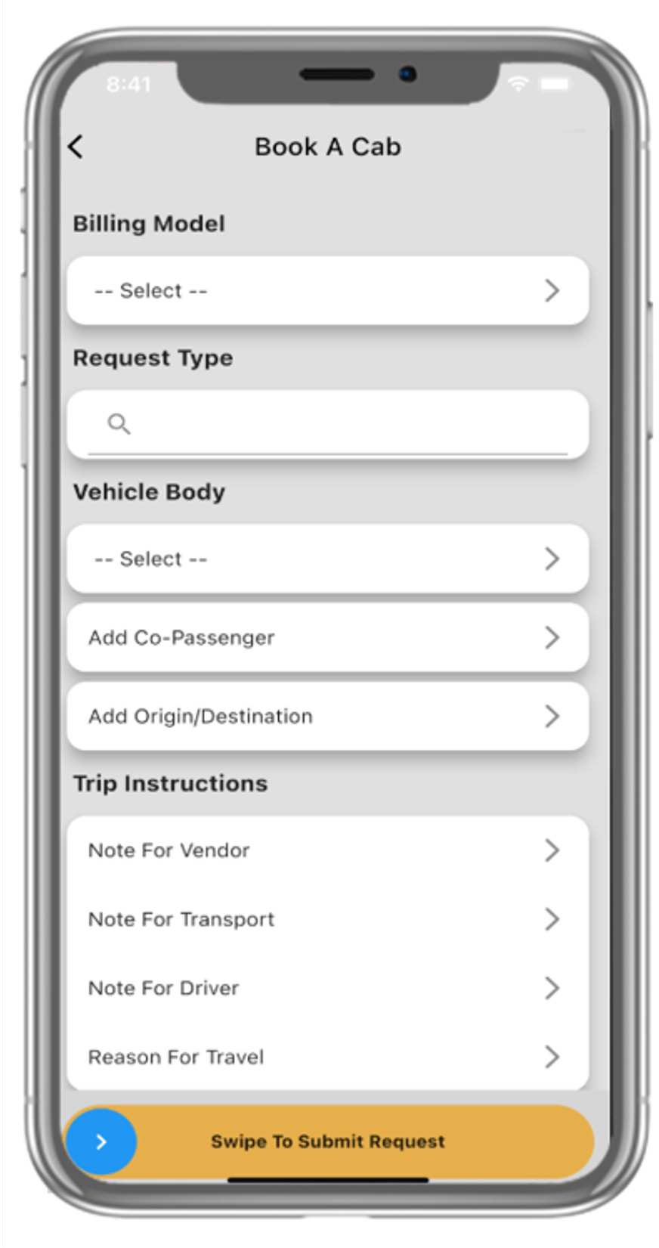
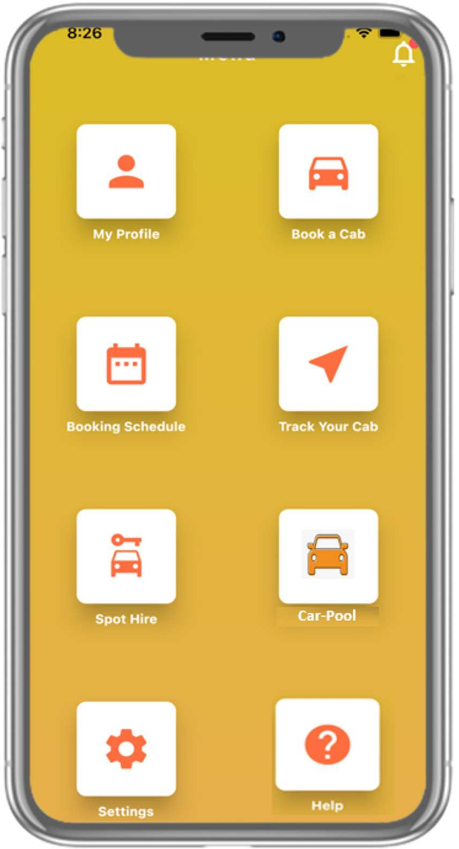
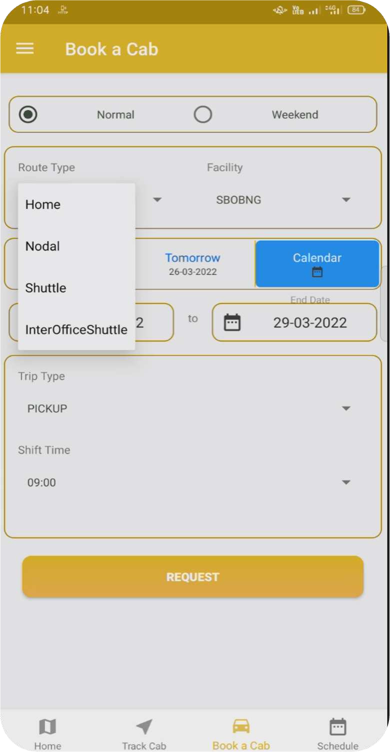
Employee app – One app for all employee transport needs
All operations
Shift| Spot-hire
Shift transport users
Home| Nodal| Shuttle| Inter-facility shuttle
Spot-hire users
Adhoc | Luxury | Spot-rental | Disposal
NGFV India Pvt. Ltd.| www.efmfm.com

Slide 6
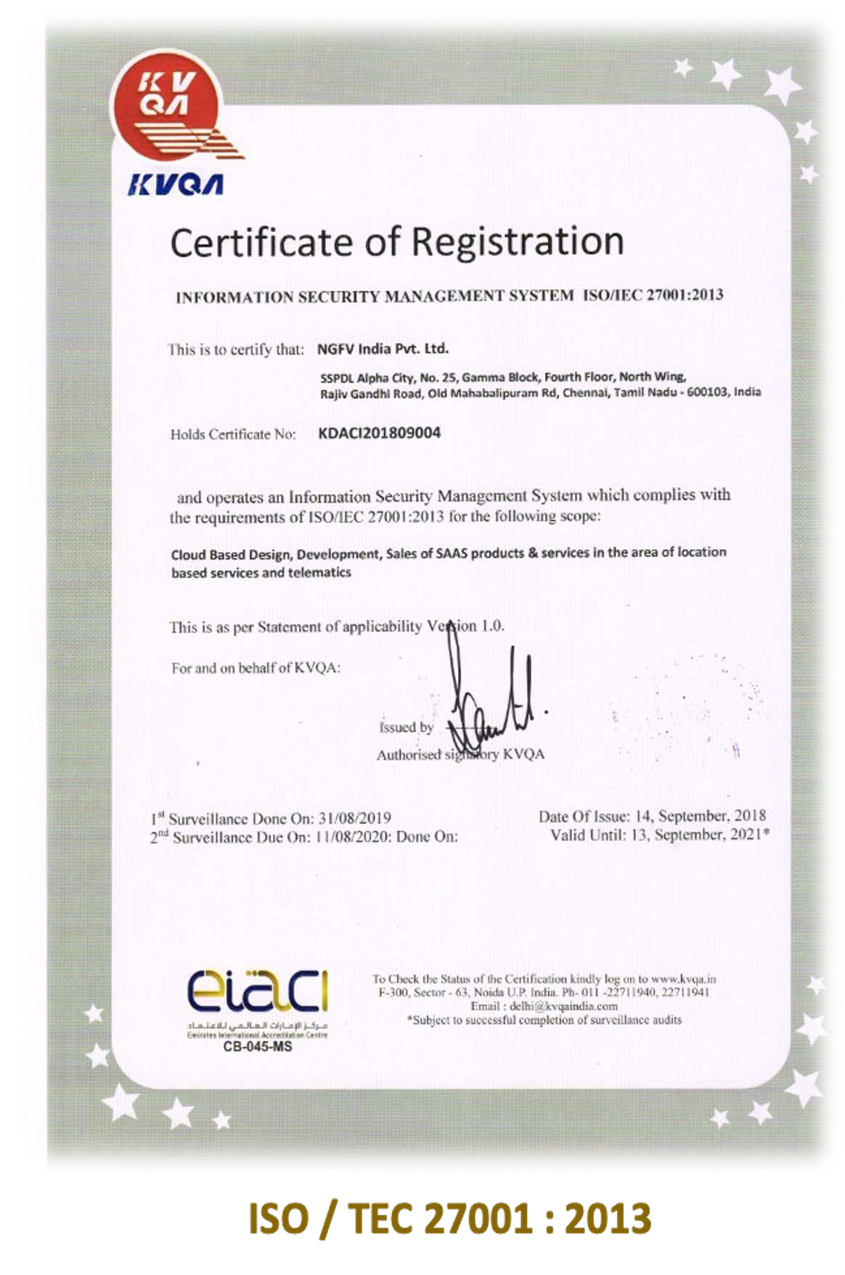
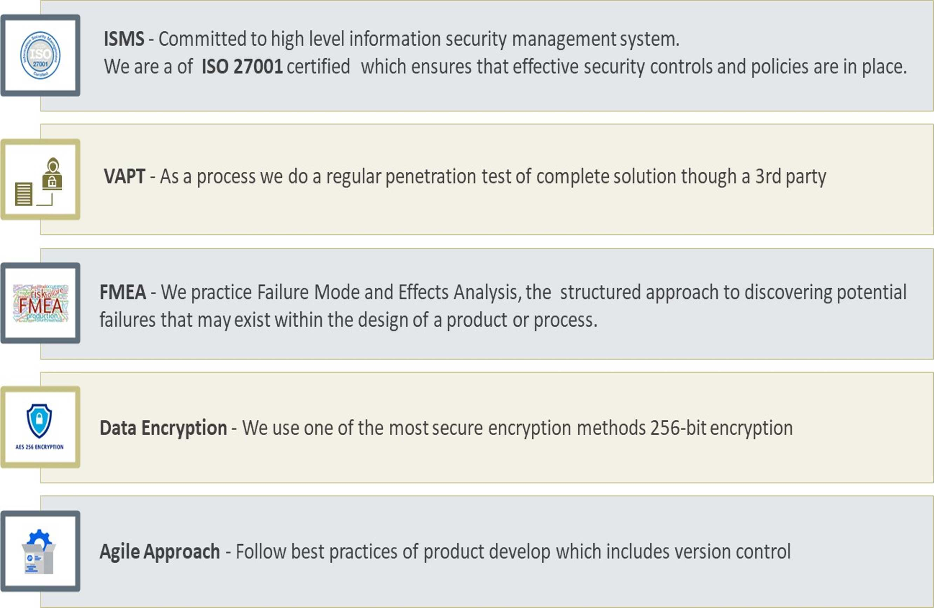

Data security & Eisk Mitigation Strategies – Global Best practises
NGFV India Pvt. Ltd.| www.efmfm.com

Slide 7
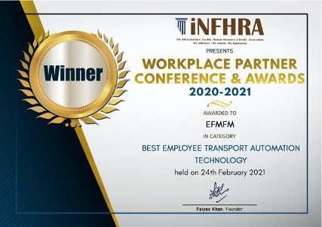
Industry First - Innovation
Employee Safety & Experience
Accommodates last moment changes – Smart request | late stay |Taxi reimbursement | employee Trip reject option
Multi level SOS escalation – Multi-stage approach with SMS & auto IVR calls
Female Safety - Exclusive tracking dash-board | Female Safe Reach mechanism | Panic button integration
Employee feedback dash-board – Homes reach conformation
Drop-zone attendance – Employee safety & help No-show management
Digital QR code – Trip wise available on Driver app | vicinity linked QR enablement
Special needs – Cradle for Women with child | Pregnant Lady | Medical needs |Specially challenged
On route Alerts - Geo-fence violation alert | Vehicle halting alert |route deviation alert
Operational Flexibility
Field app – Separate access to Vendor supervisors , Transport team-, Compliance team, Security team- Paperless operations & Ground compliances
Dash boards – Operations | Vendor |Cost |Transport - Corporate monitoring
Dynamic reports – flexibility to user for creating own report format
Access management – UI based, Facility | Role | Module | Read & Write access
System configurations – system can be configured each facility wise
Electric vehicle deployment – Cover all fuel types
RHM & JMP – Capturing road inputs & Driver Journey Management plan
IVMS – Capturing vehicle Dynamics
Vendor billing – Partial billing | facility wise mixed billing
NGFV India Pvt. Ltd.| www.efmfm.com

Slide 8

Comprehensive Business Impact
Operational Savings
Employee Experience
Environmental Factor
Number of Routes (Reduction by 3-4% in routing cost)
Vehicle Seat Utilization (Approx. increase by 5-6%)
Employee No Show Optimization (Reduction by 5-6%)
Rostering Efficiency (3-4% time saving and reduction in manual effort)
Obtaining operational flexibility
Maintain transparency
DST Shift
Process wise live tracking
Improvement in employee satisfaction ( ESAT)
Enhanced employee security
Multiple Onboarding Option
Ease of Use
Feedback Option & driver rating
Smart Request
Female Live tracking
Late-stay Shifts
IVR and Number Masking facility
Phone Calls (90% reduction in phone calls)
Stationery (Approx. 90% cost reduction in printing trip sheet if site opt for going paperless)
Carbon Fort-print Reduction (Reduction by 1- 2% in route reduction Less vehicles on the road)
8-15 % over all saving potential
Note:
These data points are from our experience & industry standards.
Percentage of savings will be totally dependent on actual operations and usage of tool on the ground.
NGFV India Pvt. Ltd.| www.efmfm.com

Slide 9
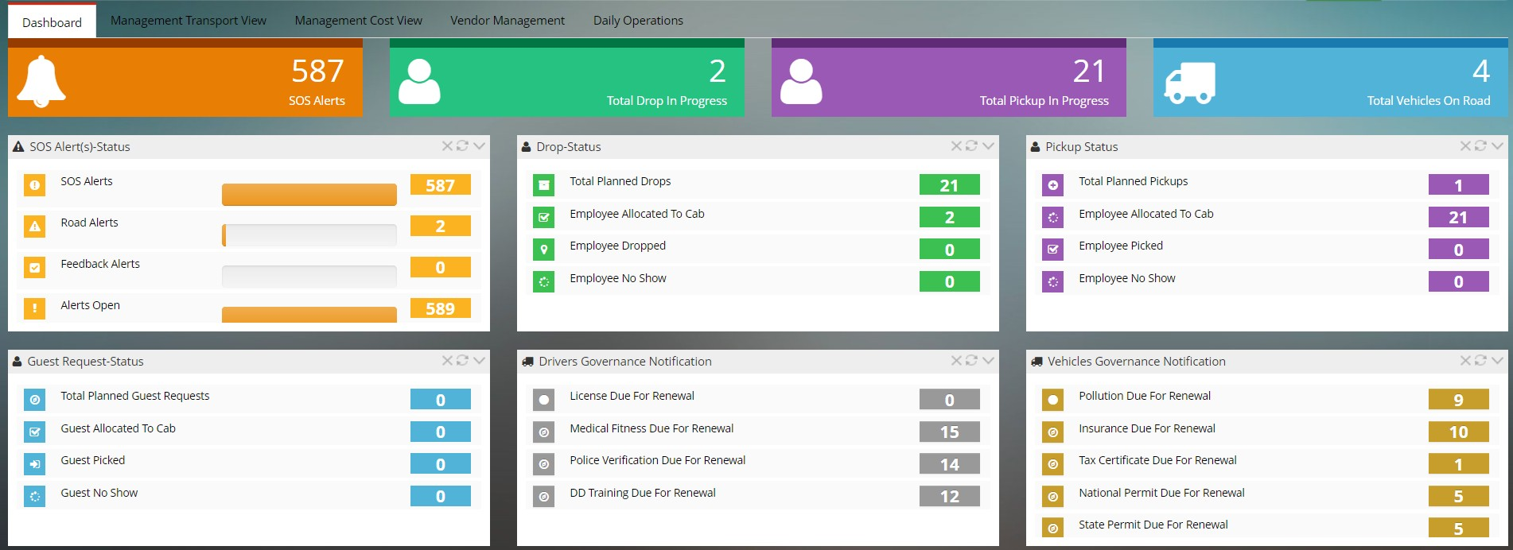
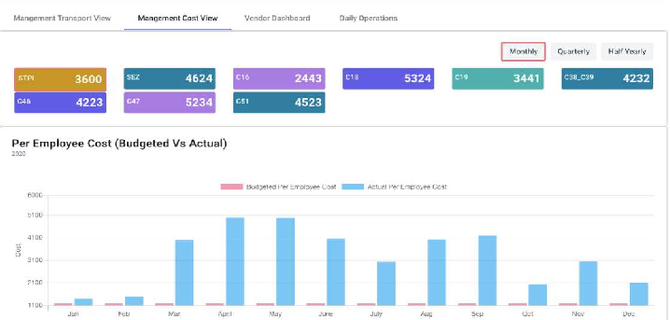
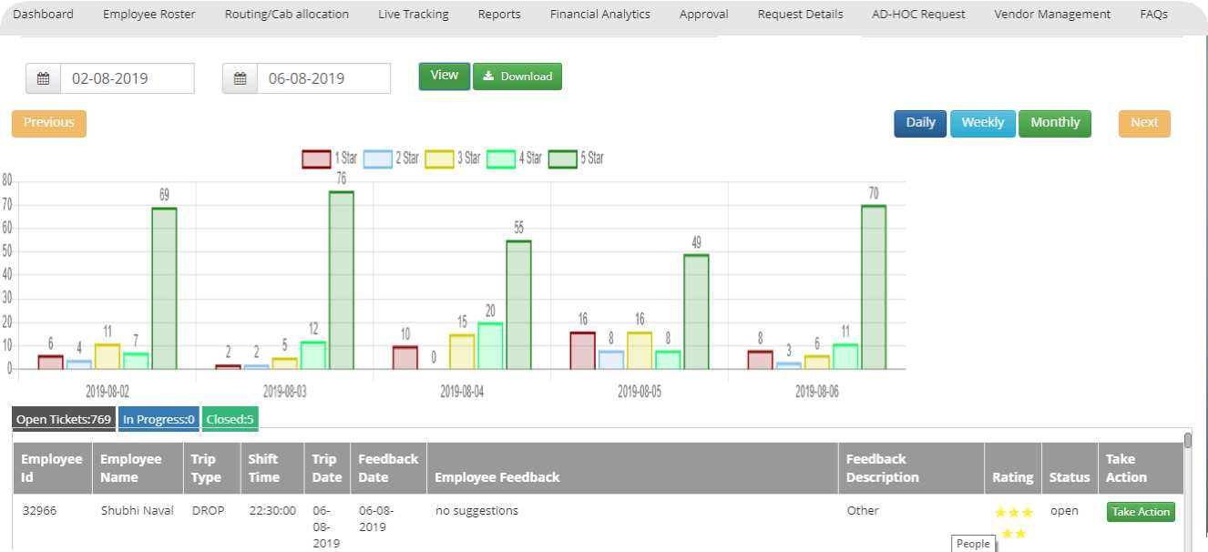
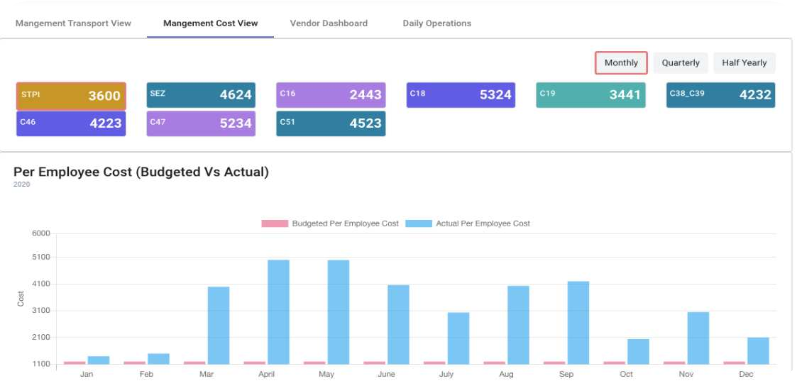
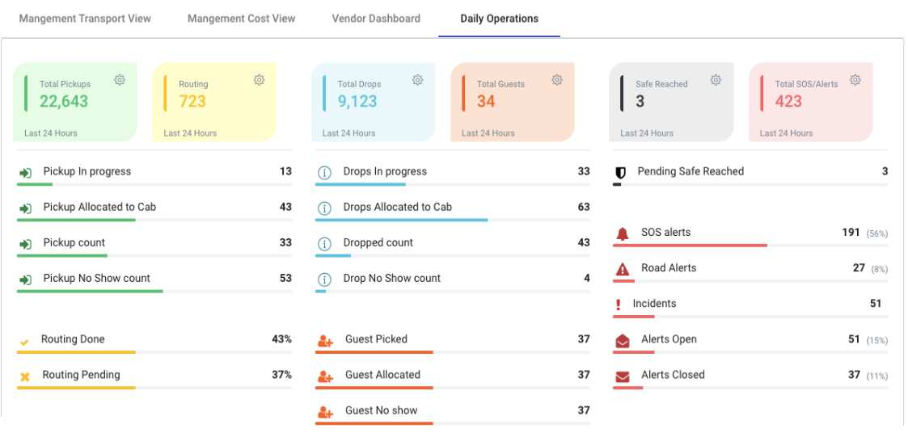
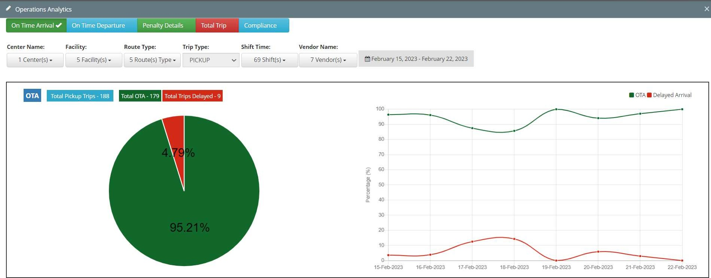
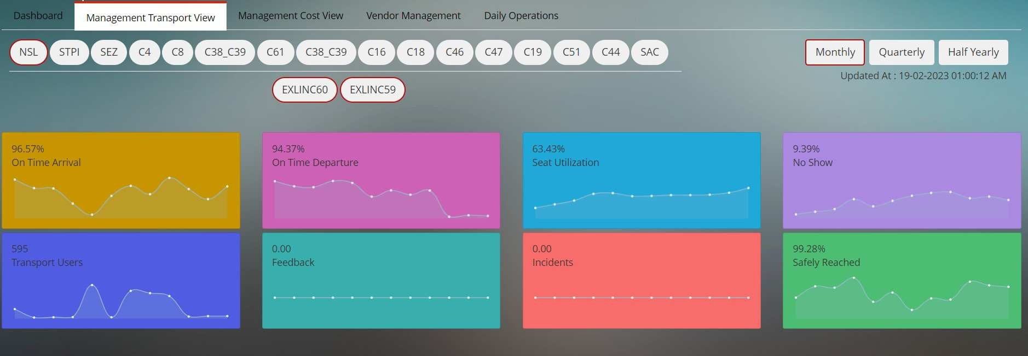
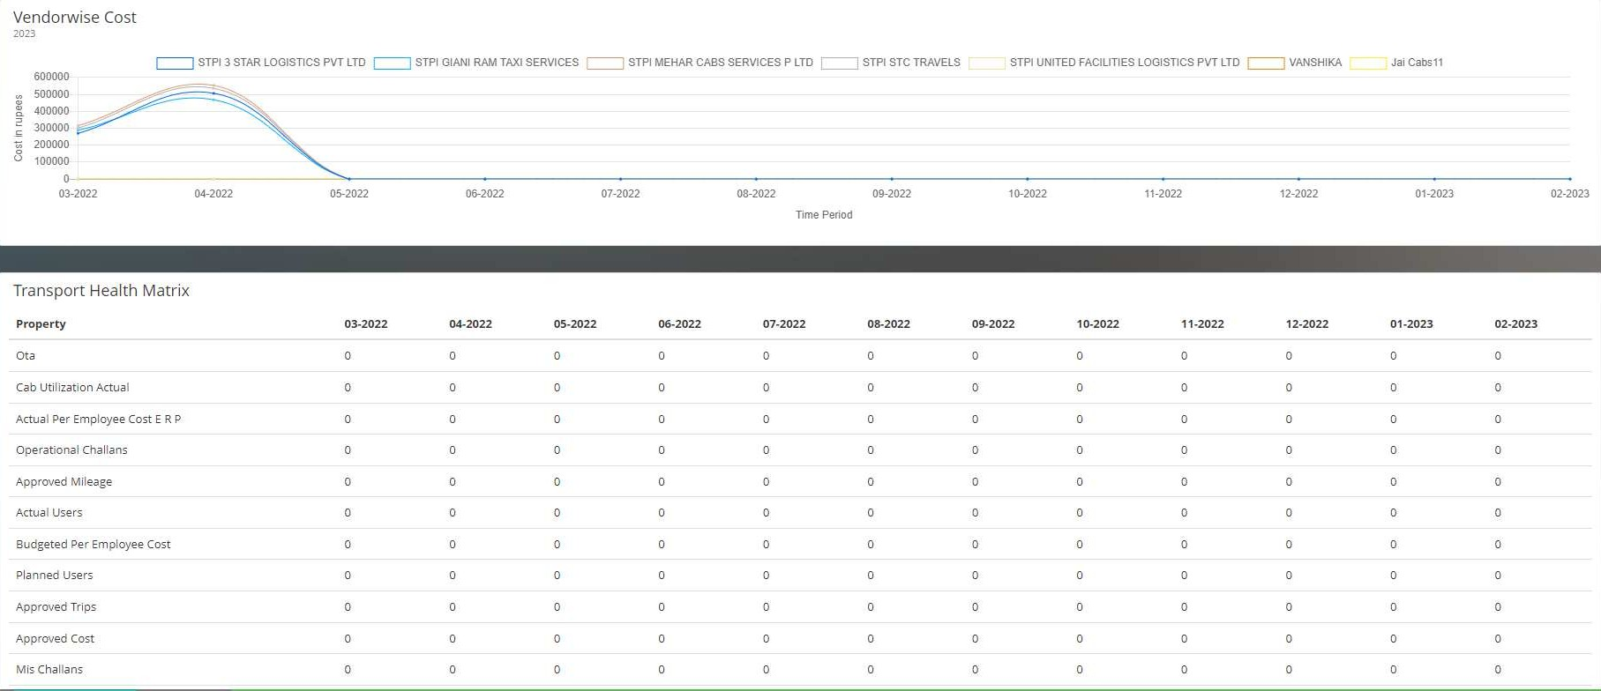
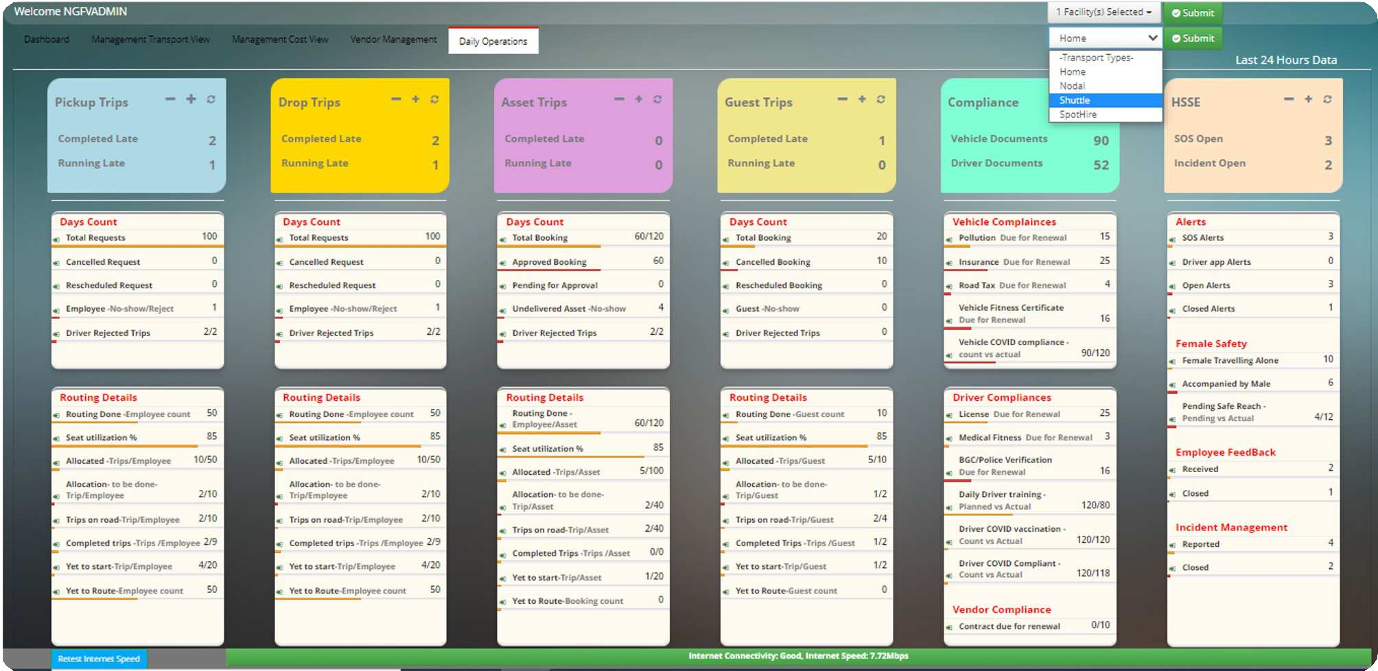
Dashboards - Total Visibility of Business
NGFV India Pvt. Ltd.| www.efmfm.com

Slide 10

Eoadmap Driven by Clear Vision
India HQ:
Chennai
4th Floor, Gamma Block, Alpha City ,
25 Rajiv Gandhi Salai (OMR), Navalur, Chennai, Tamil Nadu - 603103
Email : sales@efmfm.com
Operations
Chennai | Bangalore | Hyderabad | NCR | Pune
NGFV India Pvt. Ltd.| www.efmfm.com

